Slide 1

GitHub

Slide 2
Version Control
Version control is a system that records changes to a file or set of files over time so that you can recall specific versions later.
It allows you to revert selected files back to a previous state, revert the entire project back to a previous state, compare changes over time, see who last modified something that might be causing a problem, who introduced an issue and when, and more.

Slide 3
What is GitHub?
GitHub is a code hosting platform for version control and collaboration. It lets you and others work together on projects from anywhere.
Git allows you to work on your code with the peace of mind that everything you do is reversible.
Goals :
Speed
Simple design
Strong support for non-linear development (thousands of parallel branches)
Fully distributed
Able to handle large projects like the Linux kernel efficiently (speed and data size)

Slide 4
Git Basics
Snapshots, Not Differences
Nearly Every Operation Is Local
Git Has Integrity : Everything in Git is check-summed before it is stored and is then referred to by that checksum. This means it’s impossible to change the contents of any file or directory without Git knowing about it.
The mechanism that Git uses for this checksumming is called a SHA-1 hash. This is a 40-character string composed of hexadecimal characters (0–9 and a–f) and calculated based on the contents of a file or directory structure in Git. A SHA-1 hash looks something like this:
24b9da6552252987aa493b52f8696cd6d3b00373
Git Generally Only Adds Data

Slide 5
Git Basics
Git has three main states that your files can reside in: committed, modified, and staged.
Committed means that the data is safely stored in your local database.
Modified means that you have changed the file but have not committed it to your database yet.
Staged means that you have marked a modified file in its current version to go into your next commit snapshot.

Slide 6
Installing Git
Installing on Linux :
$ sudo apt-get install git-all
For more options, there are instructions for installing on several different Unix flavours on the Git website, at http://git-scm.com/download/linux.
Installing on Mac : A macOS Git installer is maintained and available for download at the Git website, at http://git-scm.com/download/mac.
Installing on Windows : There are also a few ways to install Git on Windows. The most official build is available for download on the Git website. Just go to http://git-scm.com/download/win and the download will start automatically.

Slide 7
Getting a Git Repository
You typically obtain a Git repository in one of two ways :
You can take a local directory that is currently not under version control, and turn it into a Git repository, or
You can clone an existing Git repository from elsewhere.
Initializing a Repository in an Existing Directory : If you have a project directory that is currently not under version control and you want to start controlling it with Git, you first need to go to that project’s director.
$ cd /c/user/my_project
$ git init
Cloning an Existing Repository
$ git clone https://github.ibm.com/context/cognitive-data-platform.git

Slide 8
Getting a Git Repository
Checking the Status of Your Files
$ git status
Tracking New Files :
$ git add filename.ext
Ignoring Files : Often, you’ll have a class of files that you don’t want Git to automatically add or even show you as being untracked. These are generally automatically generated files such as log files or files produced by your build system. In such cases, you can create a file listing patterns to match them named .gitignore.
# ignore all .a files
*.a
# but do track lib.a, even though you're ignoring .a files above
!lib.a
# only ignore the TODO file in the current directory, not subdir/TODO /TODO
# ignore all files in the build/ directory
build/
# ignore all .pdf files in the doc/ directory and any of its subdirectories
doc/**/*.pdf

Slide 9
Getting a Git Repository
Viewing Your Staged and Unstaged Changes :
To see what you’ve changed but not yet staged, type git diff with no other arguments :
$git diff
If you want to see what you’ve staged that will go into your next commit, you can use :
$ git diff --staged
Committing Your Changes : Now that your staging area is set up the way you want it, you can commit your changes. Remember that anything that is still unstaged — any files you have created or modified that you haven’t run git add on since you edited them — won’t go into this commit. They will stay as modified files on your disk. In this case, let’s say that the last time you ran git status, you saw that everything was staged, so you’re ready to commit your changes. The simplest way to commit is to type
$ git commit -m "[commit message]"

Slide 10
Undoing Things
At any stage, you may want to undo something. Here, we’ll review a few basic tools for undoing changes that you’ve made.
$ git commit -m 'initial commit’
$ git add forgotten_file
$ git commit –amend
Unstaging a Staged File : $ git reset HEAD CONTRIBUTING.md
Unmodifying a Modified File : What if you realize that you don’t want to keep your changes to the sample.md file? How can you easily unmodify it — revert it back to what it looked like when you last committed?
$ git checkout -- CONTRIBUTING.md
Remember, anything that is committed in Git can almost always be recovered. Even commits that were on branches that were deleted or commits that were overwritten with an --amend commit can be recovered. However, anything you lose that was never committed is likely never to be seen again.

Slide 11
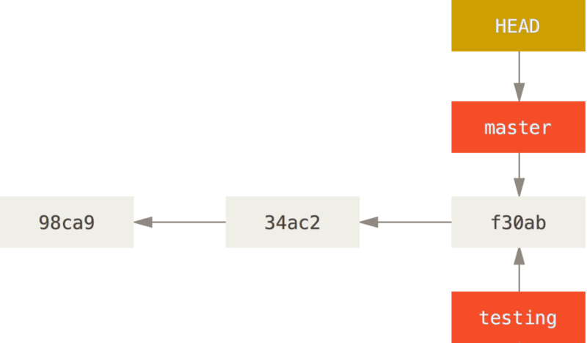
Git Branching
Nearly every VCS has some form of branching support. Branching means you diverge from the main line of development and continue to do work without messing with that main line. In many VCS tools, this is a somewhat expensive process, often requiring you to create a new copy of your source code directory, which can take a long time for large projects.
Git encourages workflows that branch and merge often, even multiple times in a day. Understanding and mastering this feature gives you a powerful and unique tool and can entirely change the way that you develop.
Creating a New Branch :
$ git branch testing

Slide 12
Branching and Merging
Basic Branching : First, let’s say you’re working on your project and have a couple of commits already on the master branch.
You’ve decided that you’re going to work on issue #53 in whatever issue-tracking system your company uses. To create a new branch and switch to it at the same time, you can run the git checkout command with the -b switch:
$ git checkout -b iss53

Slide 13
Branching and Merging
You work on your module and do some commits. Doing so moves the iss53 branch forward, because you have it checked out (that is, your HEAD is pointing to it):
$ vim index.html
$ git commit -m 'added a new footer [issue 53]'
Now you get the call that there is an issue with the module, and you need to fix it immediately. With Git, you don’t have to deploy your fix along with the iss53 changes you’ve made, and you don’t have to put a lot of effort into reverting those changes before you can work on applying your fix to what is in production. All you have to do is switch back to your master branch.

Slide 14
Branching and Merging
$ git checkout master
Next, you have a hotfix to make. Let’s create a hotfix branch on which to work until it’s completed:
$ git checkout –b hotfix
$ vim index.html
$ git commit -a -m 'fixed the broken email address’
You can run your tests, make sure the hotfix is what you want, and finally merge the hotfix branch back into your master branch to deploy to production. You do this with the git merge command:
$ git checkout master
$ git merge hotfix

Slide 15
Branching and Merging
After your super-important fix is deployed, you’re ready to switch back to the work you were doing before you were interrupted. However, first you’ll delete the hotfix branch, because you no longer need it — the master branch points at the same place. You can delete it with the -d option to git branch:
$ git branch –d hotfix
Now you can switch back to your work-in-progress branch on issue #53 and continue working on it.
$ git checkout iss53
$ vim index.html
$ git commit -a -m 'finished the new module [issue 53]'
It’s worth noting here that the work you did in your hotfix branch is not contained in the files in your iss53 branch. If you need to pull it in, you can merge your master branch into your iss53 branch by running $ git merge master

Slide 16
Rebasing
The easiest way to integrate the branches, as we’ve already covered, is the merge command. It performs a three-way merge between the two latest branch snapshots (C3 and C4) and the most recent common ancestor of the two (C2), creating a new snapshot (and commit).
However, there is another way: you can take the patch of the change that was introduced in C4 and reapply it on top of C3. In Git, this is called rebasing. With the rebase command, you can take all the changes that were committed on one branch and replay them on another one.
$ git checkout experiment
$ git rebase master

Slide 17
Git Commands
Getting and Creating Projects
Basic Snapshotting
Command | Description
git init | Initialize a local Git repository
git clone ssh://git@github.com/ [username]/[repository-name].git | Create a local copy of a remote repository
Command | Description
git status | Check status
git add [file-name.txt] | Add a file to the staging area
git add -A | Add all new and changed files to the staging area
git commit -m "[commit message]" | Commit changes
git rm -r [file-name.txt] | Remove a file (or folder)

Slide 18
Git Commands
Getting and Creating Projects
Command | Description
git branch | List branches (the asterisk denotes the current branch)
git branch -a | List all branches (local and remote)
git branch [branch name] | Create a new branch
git branch -d [branch name] | Delete a branch
git push origin --delete [branchName] | Delete a remote branch
git checkout -b [branch name] | Create a new branch and switch to it
git checkout -b [branch name] origin/[branch name] | Clone a remote branch and switch to it
git checkout [branch name] | Switch to a branch
git checkout - | Switch to the branch last checked out
git checkout -- [file-name.txt] | Discard changes to a file
git merge [branch name] | Merge a branch into the active branch
git merge [source branch] [target branch] | Merge a branch into a target branch
git stash | Stash changes in a dirty working directory
git stash clear | Remove all stashed entries

Slide 19
Git Commands
Sharing & Updating Projects
Command | Description
git push origin [branch name] | Push a branch to your remote repository
git push -u origin [branch name] | Push changes to remote repository (and remember the branch)
git push | Push changes to remote repository (remembered branch)
git push origin --delete [branch name] | Delete a remote branch
git pull | Update local repository to the newest commit
git pull origin [branch name] | Pull changes from remote repository
git remote add origin ssh://git@github.com/[username]/[repository-name].git | Add a remote repository

Slide 20
Git Commands
Inspection & Comparison
Command | Description
git log | View changes
git log --summary | View changes (detailed)
git diff [source branch] [target branch} | Preview changes before merging

Slide 21
?????????…

Slide 22
Lab Exercise
Creating Repository in Enterprise Git
Add a new SSH key
Profile update / Add Collaborators
Clone
Create Issues
Add / Update files
Create Branch
Commit
Create / Assign PR
Link PR with Issues
Review PR
Add / Update files
Push the changes
Delete the branch
Close the PR and issue

Slide 23
Thank You…

